Slide 1


Fertilizer Recommendation
This presentation explores a Smart Fertilizer Recommendation System utilizing AI/ML. It incorporates soil data and fertilizer NPK values to optimize agricultural practices, ensuring efficient nutrient management for crop growth.
23R11A0514 - JASHWANTH
23R11A05C5 - CHINNAIAH
23R11A05H4 - MOHITH

Slide 2
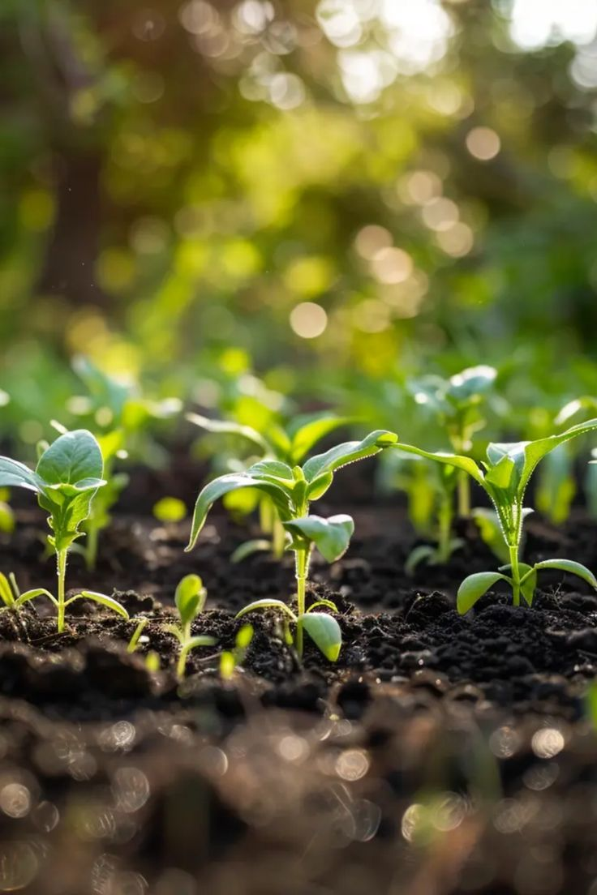
Introduction
The Fertilizer Recommendation System is an AI/ML-based solution designed to help farmers and agricultural professionals choose the most suitable fertilizer for their crops. By analyzing key agricultural parameters such as soil type, crop type, temperature, humidity, moisture content, and NPK (Nitrogen, Phosphorus, Potassium) levels, the system provides smart, data-driven fertilizer recommendations. This project aims to improve crop yield, reduce overuse of chemicals, and promote sustainable farming practices through intelligent decision-making.

Slide 3



Understanding Soil Composition
Nutrient Content
Key nutrients such as nitrogen (N), phosphorus (P), and potassium (K) are vital for soil fertility, commonly represented by NPK values.
Soil Types
2
Various soil types, including sandy, clay, and loamy soils, each have unique characteristics impacting nutrient retention and drainage.
1
Soil Testing
Conducting regular soil tests is critical to assess nutrient levels, pH, and organic matter content, aiding in effective fertilization.
3

Slide 4
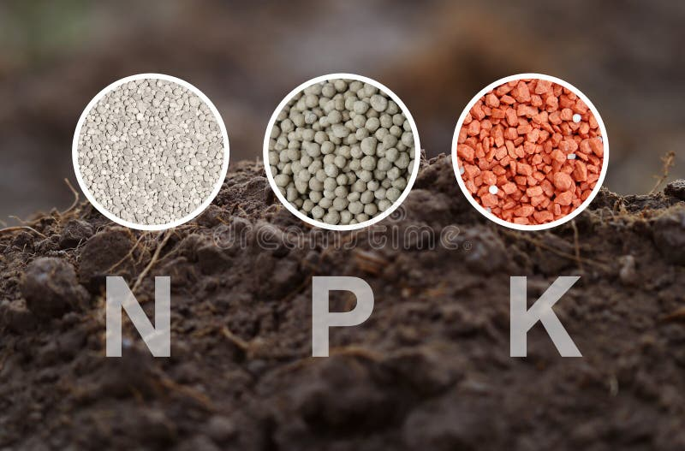



Fertilizer NPK Values
Role of Phosphorus
Role of Potassium
What is NPK?
Role of Nitrogen
NPK stands for Nitrogen, Phosphorus, and Potassium, the three essential macronutrients for plant growth, each playing a unique role in promoting healthy crops.
Nitrogen is vital for leaf development and overall plant vigor, influencing growth rates and yield potential.
Phosphorus promotes root development, flowering, and fruiting, crucial for crop productivity and quality.
Potassium enhances drought resistance, disease tolerance, and overall plant health, making it essential for robust crop growth.

Slide 5


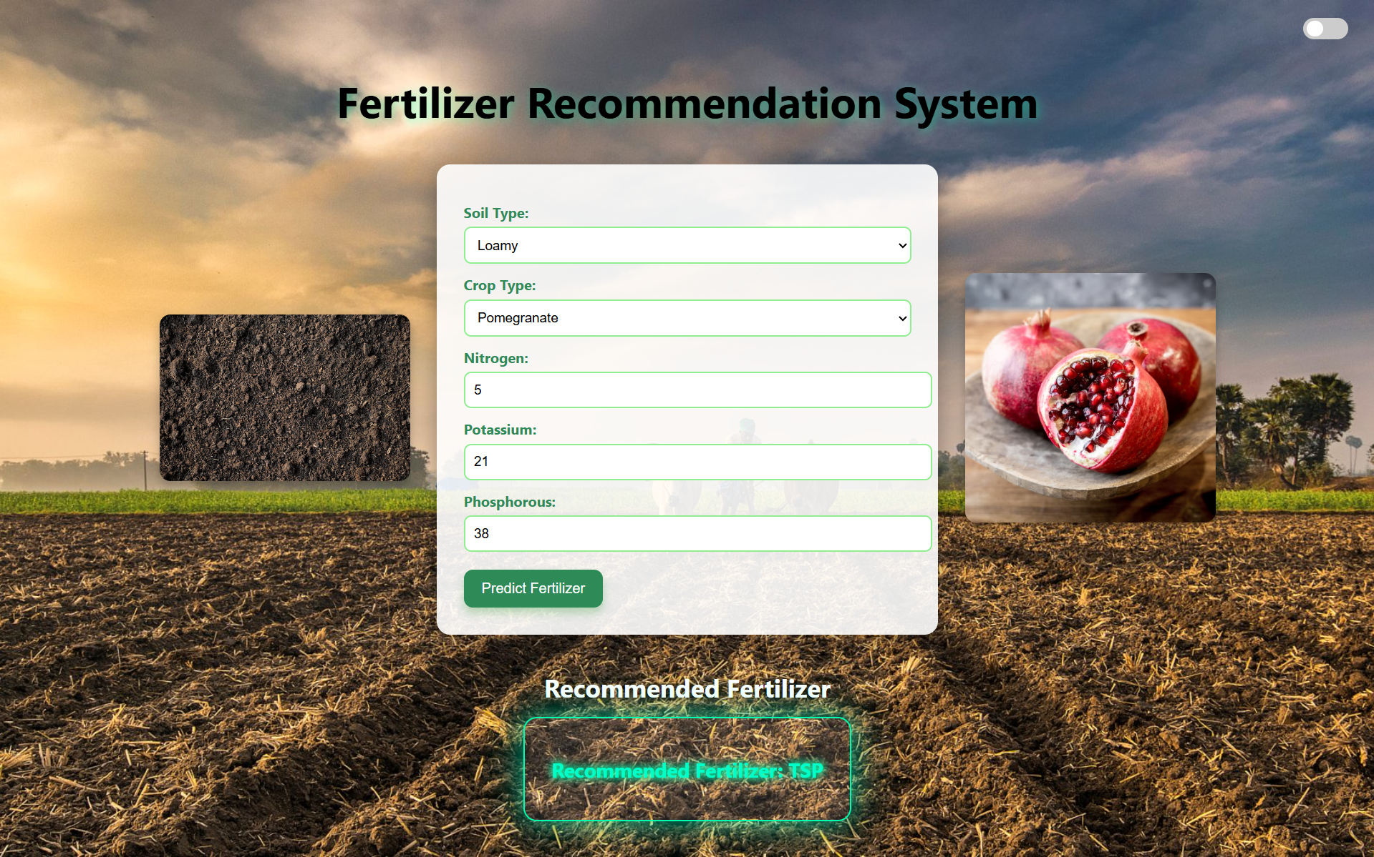
Components of the Recommendation System
Machine Learning Algorithms
User Interface
Algorithms analyze historical data to predict the optimal NPK ratios based on specific crop needs and soil conditions, enhancing accuracy.
A user-friendly interface allows farmers to input data and receive instant recommendations, facilitating easy implementation of suggested fertilization strategies.

Slide 6
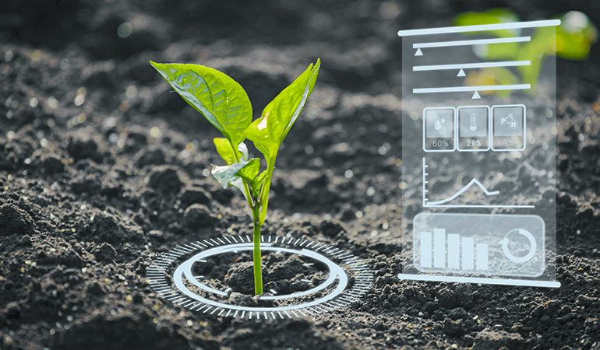
Technologies Used
Python: Core language used for machine learning logic, data preprocessing, and backend development.
Scikit-learn: Used to build and train the classification model
Pandas: For data handling and manipulation
Numpy: For numerical operations and array processing
Joblib: To save and load the trained ML model
Flask , HTML , CSS
.

Slide 7
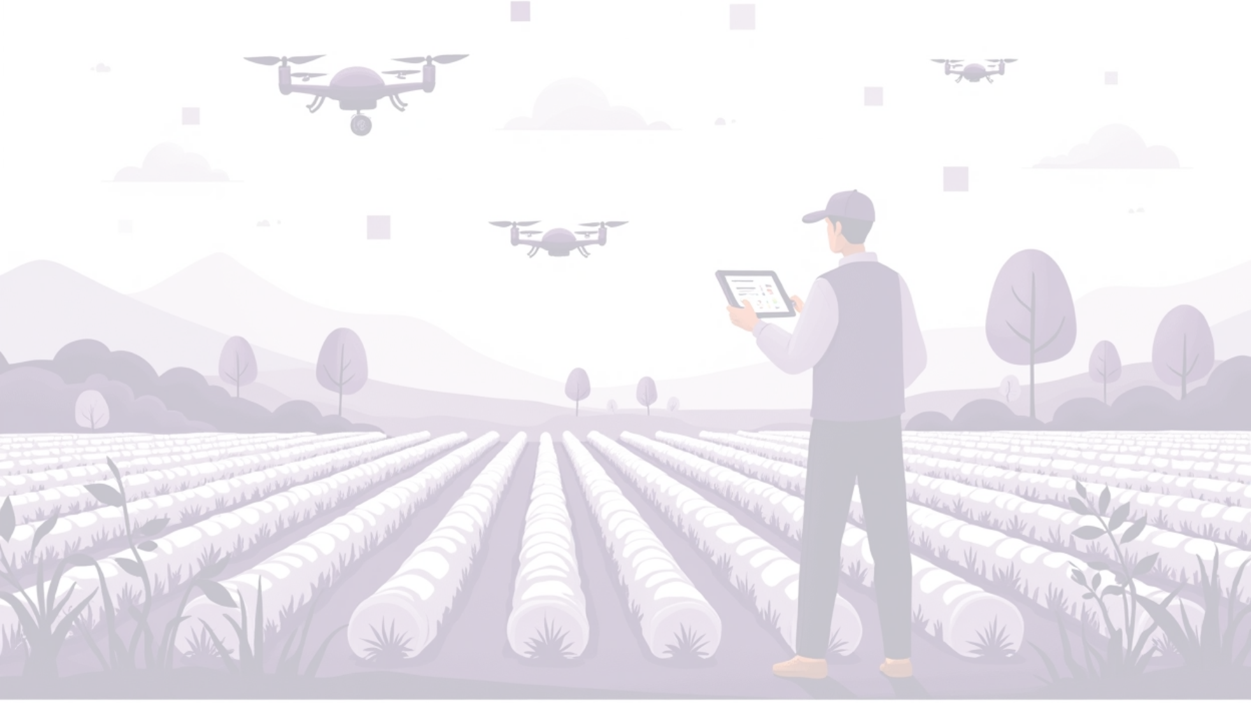
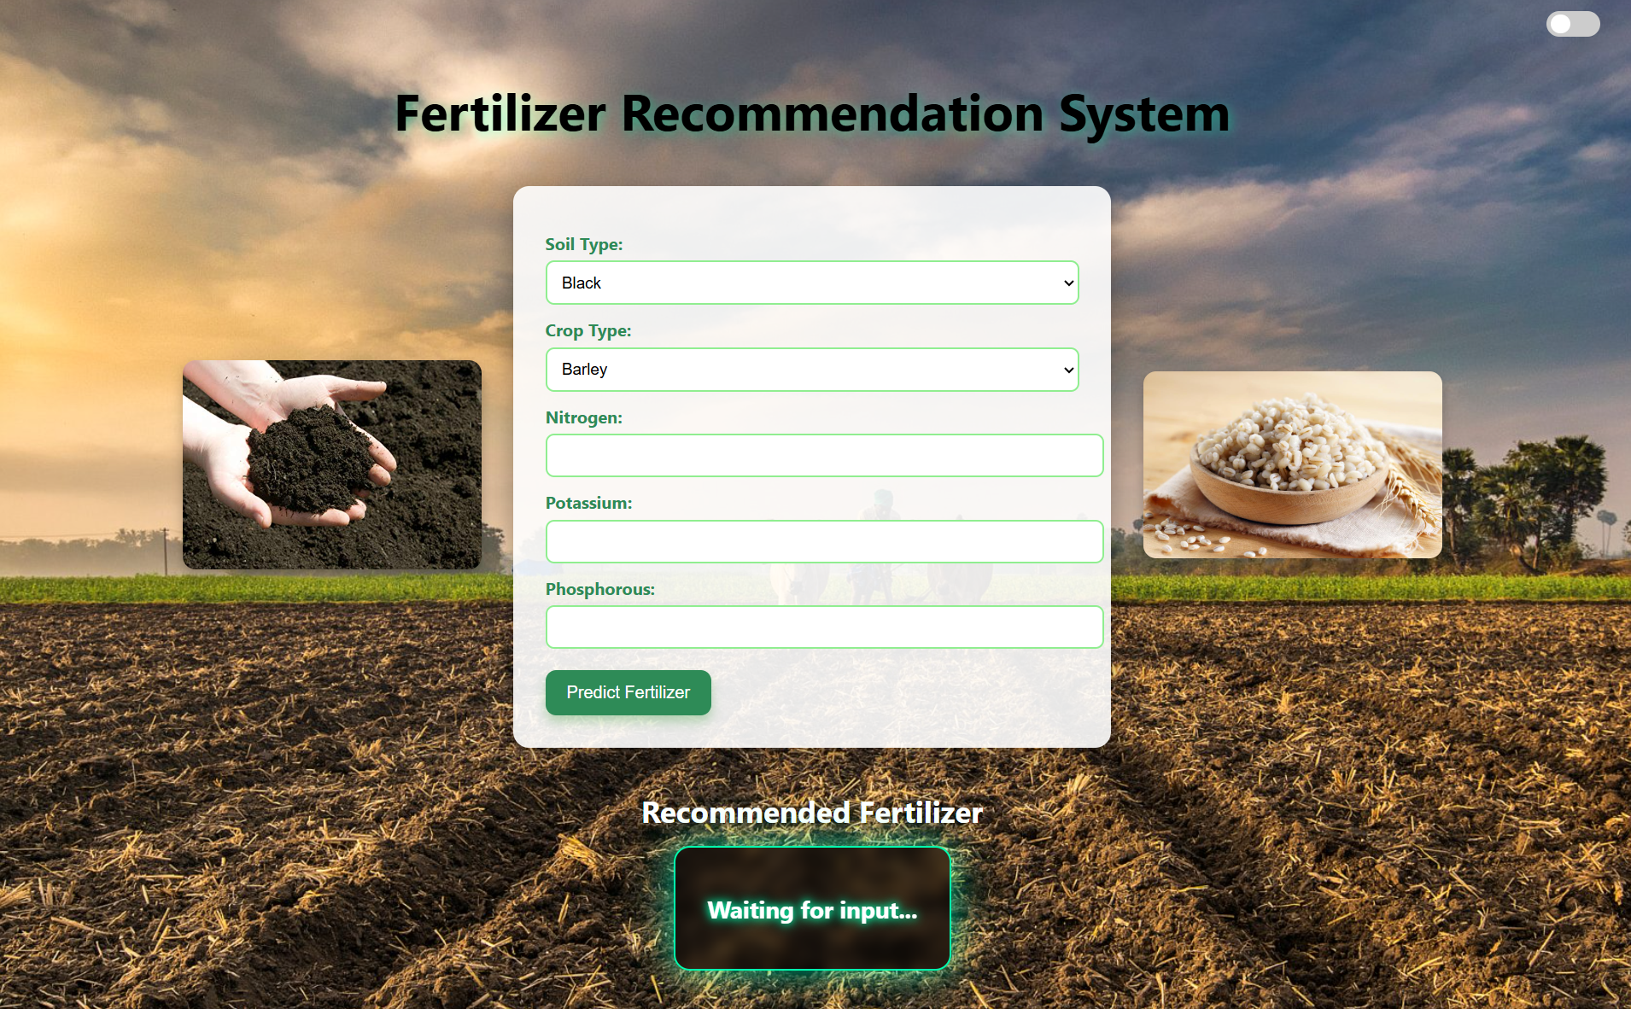
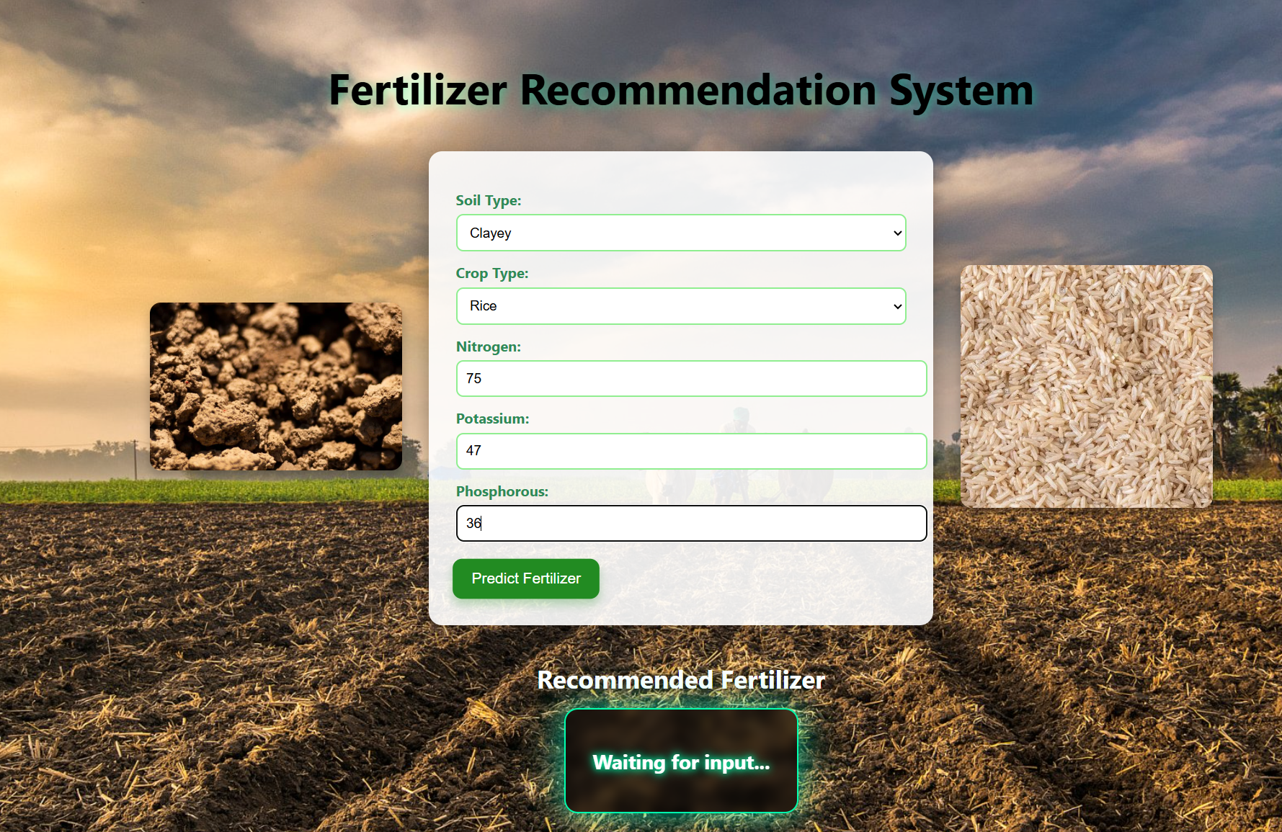
OUTPUT

Slide 8
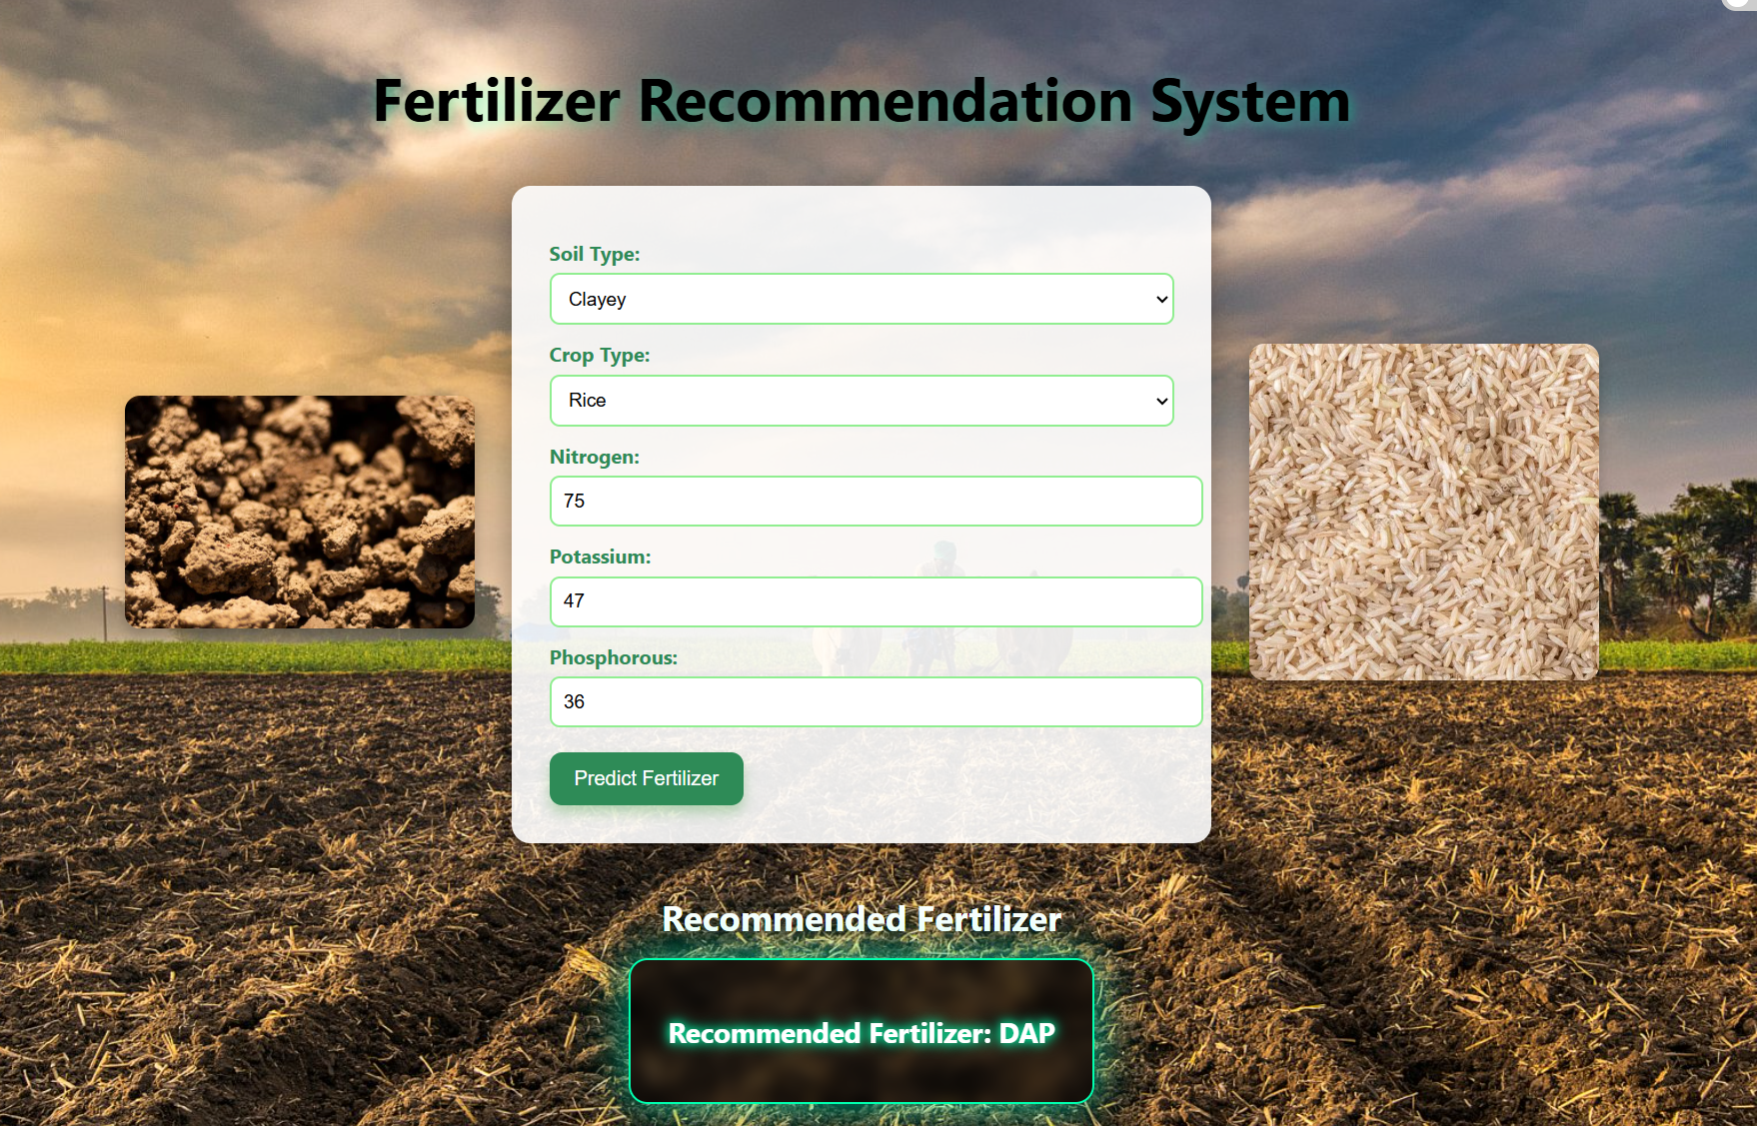

Slide 9
Conclusion
The Fertilizer Recommendation System successfully demonstrates how machine learning can revolutionize modern agriculture. By leveraging environmental and soil parameters, the system provides accurate and efficient fertilizer suggestions tailored to specific crop and soil needs. This not only helps in increasing crop productivity but also promotes sustainable and eco-friendly farming practices. With further development and integration, such systems can greatly assist farmers in making informed decisions and contributing to the future of smart agriculture.
.

Slide 10
THANK YOU

